Slide 1
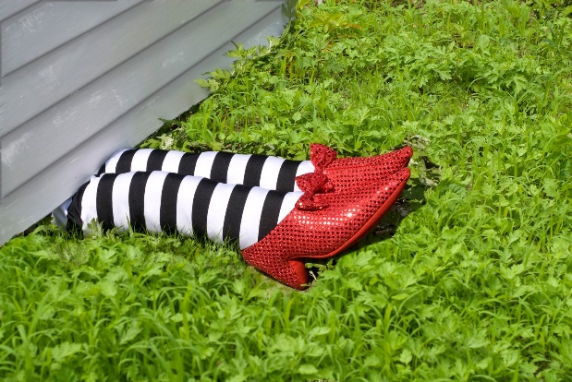
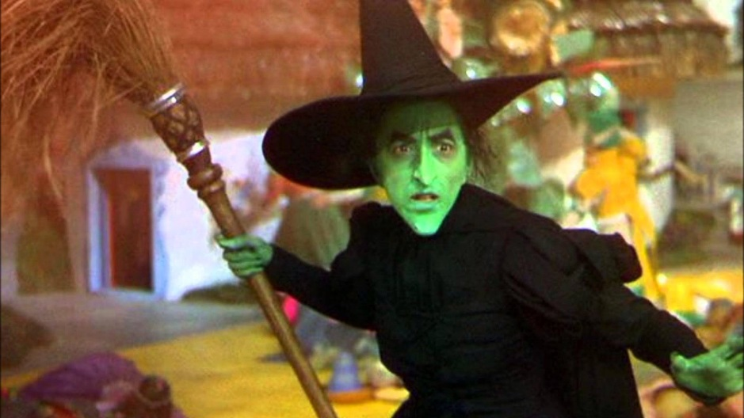
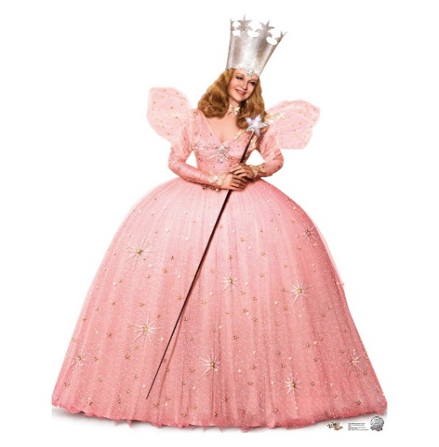
Departures from the Guide or
“Witch” Departure are We Talking About?
R. Wayne Barbee, Ph.D., Susan B. Harper, DVM, MS, Eileen Morgan, BS,
Jennifer Perkins, MA, CPIA, and Noé Tirado-Muñiz, DMV, DVM, MS, CPIA
Notes:
Facilitator: Understanding departures has been identified as a challenging topic for most IACUC members and administrators, and we are honored to be selected to talk to you about it today.

Slide 2
Intended Audience:
The following presentation was designed for both the new and the seasoned IACUC administrator and IACUC members.
For those new to the subject, this will serve as an “ice breaking” introduction to the subject.
Seasoned members may find the scenarios and following discussions enlightening and may help them manage situations within their own programs.
Notes:
Facilitator: This presentation was designed for:
New and the seasoned IACUC administrators and IACUC members.
For new ones this might serve as an “ice breaking” introduction to the subject.
Seasoned members may find the scenarios and following discussions enlightening and may help them manage situations within their own programs.

Slide 3
Learning Goals
The goals of this training are to help IACUC members and administrative staff categorize “departures” from the Guide and fulfill the committee’s relevant oversight responsibilities.
Notes:
Facilitator: The Guide describes minimum standards of care, and there are expectations that institutions will adhere to these standards unless there is a valid reason to do otherwise. Departures sometimes occur when this becomes necessary.
For this session, the learning goals are . . .

Slide 4
Learning Objectives
Define “departure” relative to the Guide.
Compare the terms “must” vs “should” vs “may.”
Differentiate between departures and noncompliance.
Use published guidance on departures correctly.
Determine when departures need to be reported in the semi-annual report and/or tracked.
Notes:
Facilitator: And by the end of this presentation, we are confident that you will be able to . . . .

Slide 5
What is a departure?
Shout out a few words that come to mind
when you hear the word “departure.”
Notes:
Facilitator: (SHOUT OUT EXERCISE) As an IACUC member or administrator, what are a few words that come to mind when you hear the word “departure”?
Facilitator assistant records responses from the audience on a flip chart.
Facilitator: As you can see, there are a lot of differences in the level of understanding when we talk about departures. This is the reason we were assigned this topic.

Slide 6
As you can see, there are a lot of differences in the level of understanding when we talk about departures. This is the reason we are discussing this topic.
Notes:
Facilitator: (SHOUT OUT EXERCISE) As an IACUC member or administrator, what are a few words that come to mind when you hear the word “departure”?
Facilitator assistant records responses from the audience on a flip chart.
Facilitator: As you can see, there are a lot of differences in the level of understanding when we talk about departures. This is the reason we were assigned this topic.

Slide 7
Departure
Departure was defined in an OLAW online seminar titled “Departures from the Guide,” presented on October 4, 2012, as:
A variation from the standards of the Guide that must be reported in the semi-annual report to the Institutional Official.
Notes:
Facilitator: Reads definition of a “departure,” and discusses what is NOT a departure (deviation, exception, exemption, variance).

Slide 8
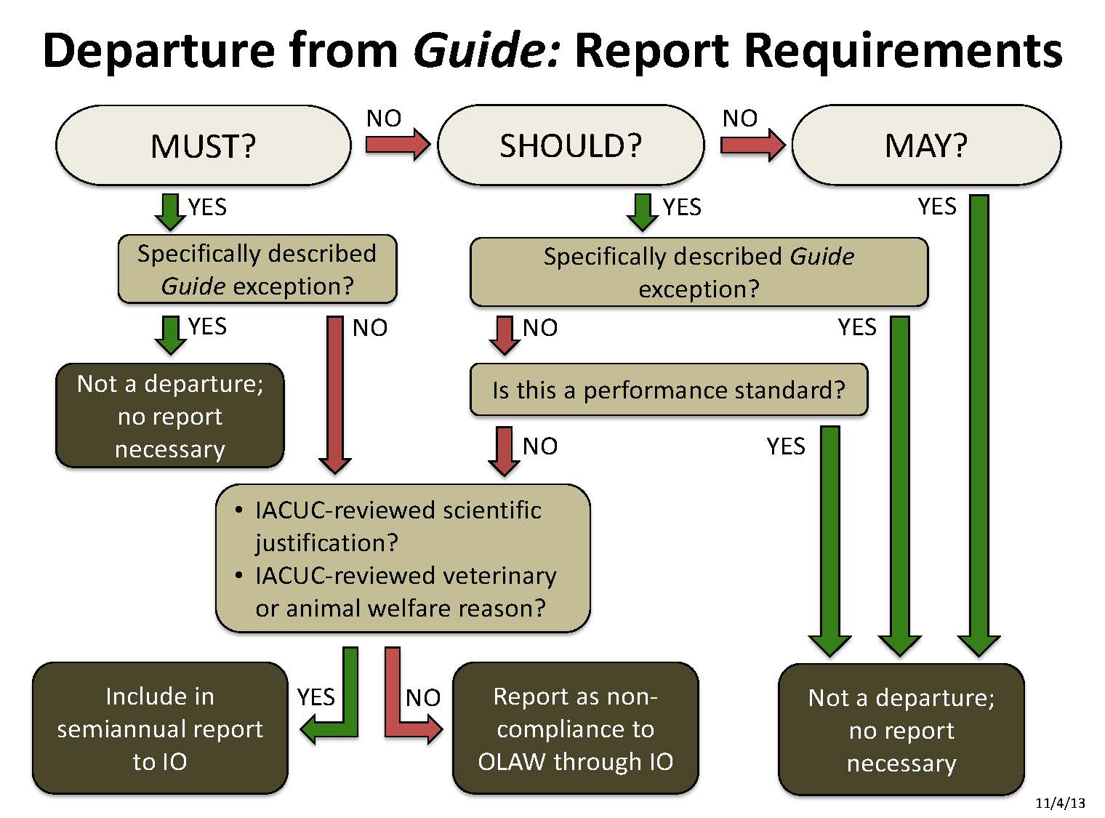
Notes:
Facilitator: You may recognize this is a tool that was developed by OLAW to assist IACUC members in correctly classifying departures.

Slide 9
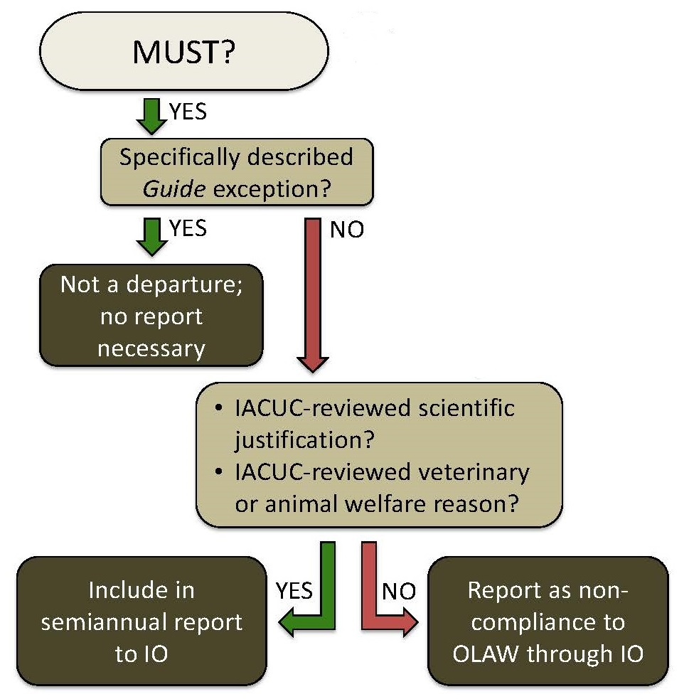
Notes:
Facilitator: The complete chart has a lot of information, and we have broken the complete flowchart into smaller components that are easier to comprehend. This is the pathway for “musts.”
Must statements are easy to recognize because they include the word “must.” Must statements are considered absolute requirements-UNLESS they include a qualifying statement (referred to as an “exception”) that allows an institution some leverage in implementing that particular requirement. (The Guide defines musts as actions that the Committee “considers imperative and mandatory duty or requirement for providing humane animal care and use.”)
As you can see, if a “must” includes a specific exemption – and the institution applies the exemption – it is not considered a departure. Otherwise, departures from a “must” requirement must be scientifically justified or based on a veterinary or animal welfare consideration.

Slide 10
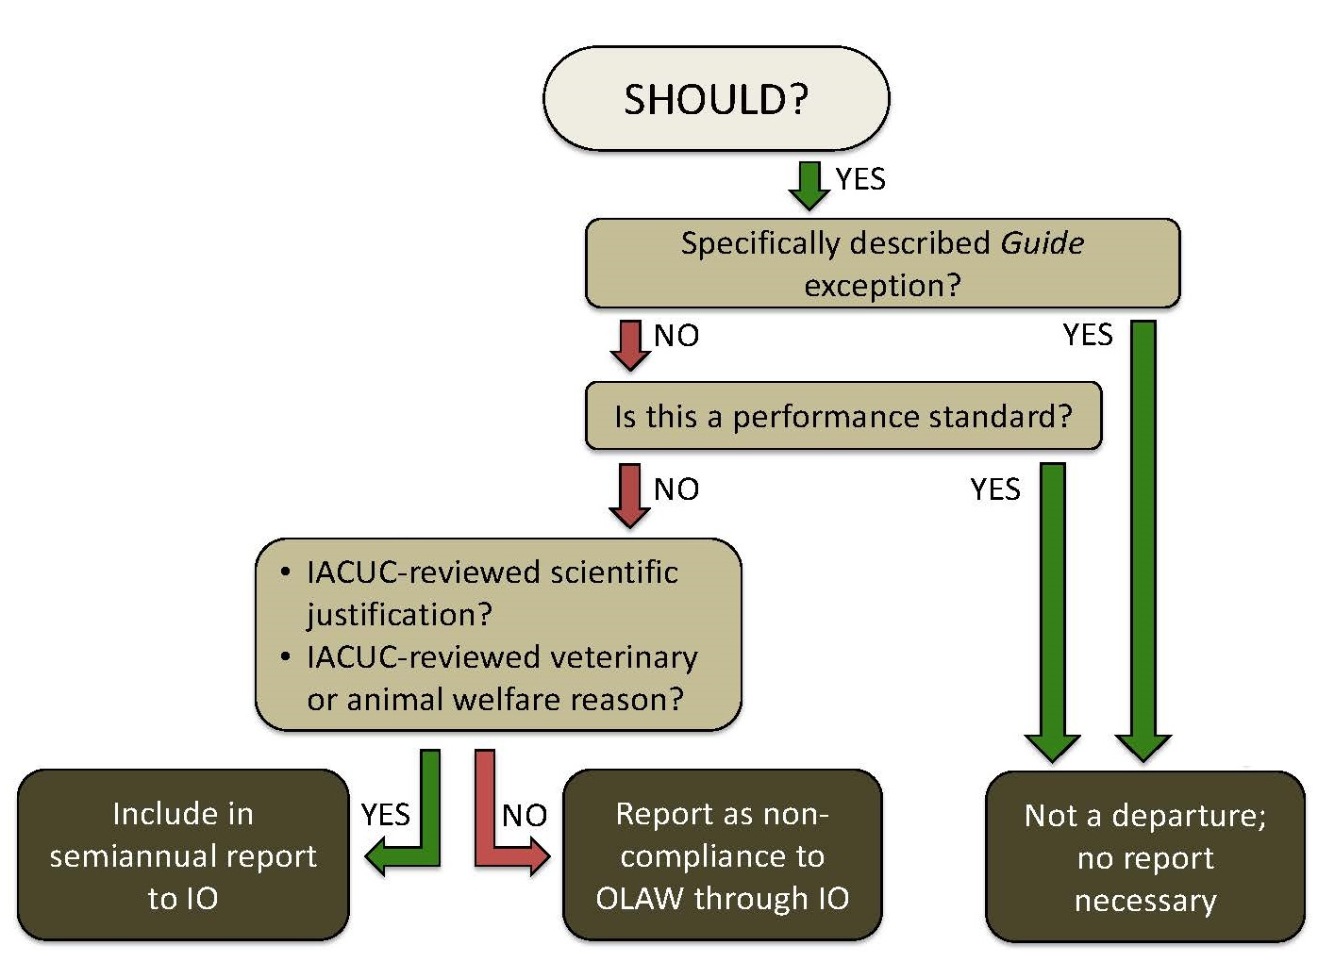
Notes:
Facilitator: This diagram shows the pathway for “should” statements. Similar to “must” statements, “should” statements in the Guide include the word “should.”
Also similar to “must” statements, the Guide describes specific exceptions that gives institutions latitude in adopting that particular recommendation. (The Guide defines should as a strong recommendation for achieving a goal; however, the Committee recognizes that individual circumstances might justify an alternative strategy.)
As another option, institutions have the discretion to develop local performance standards that will produce the same desired outcomes as a “should” statement. The use of performance standards offers institutions flexibility to achieve the same standard of care. Following established performance standards are NOT classified as departures. It is acceptable to depart from a “should” statement when performance standards are in effect.

Slide 11
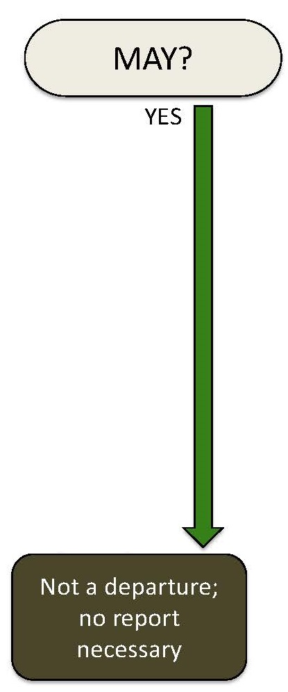
Notes:
Facilitator: By comparison, the pathway for “may” statements is relatively straightforward. “Mays” are completely optional, and not choosing to adopt a may statement is not considered a departure, and no report is needed. The Guide defines “Mays” as a “suggestion to be considered.”

Slide 12
Must, Should and May
According to the Guide:
Must- Actions considered imperative/mandatory.
Should- Strong recommendation (recognizing alternative strategies may apply).
May- A suggestion.
Notes:
Facilitator: At this stage it might be good to summarize what is a must, should and may and give a few examples of specifically described exceptions in the Guide.

Slide 13
Must Exception
  Dogs over 12 weeks of age, except bitches with litters, housed, held, or maintained by any dealer, exhibitor, or research facility, including Federal research facilities, must be provided the opportunity for exercise regularly if they are kept individually in cages, pens, or runs that provide less than two times the required floor space for that dog, as indicated by § 3.6(c)(1) of this subpart.
Notes:
An example would be dogs kept in runs with more than twice the minimum required floor space.

Slide 14
Should Exception
  Social animals should be housed in stable pairs or groups of compatible individuals unless they must be housed alone for experimental reasons or because of social incompatibility.
Notes:
An example would be mice which are normally housed in groups. If for experimental purposes (let’s say so we can measure individual urine/fecal output) or due to incompatibility (let’s say these are male mice and they are fighting) they need to be single housed, this would NOT be considered a departure based on this specific exception contained in the Guide.

Slide 15
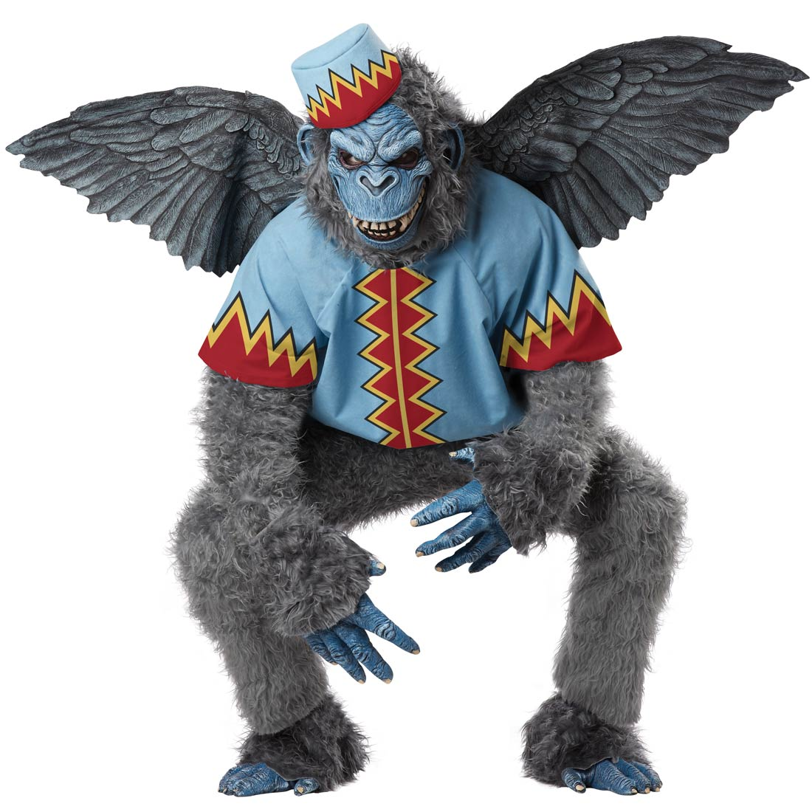
Think, Pair, and Share
A PI plans to use tethered NHPs for a chronic drug infusion study.
To ensure their safety (prevent entanglement with the tether), the tethered animals will be housed in cages that are slightly less than the minimum required height, preventing natural posturing.
The PI’s scientific justification is approved by the IACUC.
Notes:
Facilitator: Describes activity - Think, Pair, and Share about the scenario that is being handed out. We would like for you to classify the action taken by the IACUC, and also describe the committee’s oversight responsibilities relative to this particular study.
Facilitator assistants pass out flow charts and scenarios, and also provide time warnings to the group. 30 secs to think 1 min to pair; and 1 minute to share (use next slide to walk through the sharing section).

Slide 16
Think, Pair, and Share
“At a minimum, animals must have enough space to express their natural postures and postural adjustments without touching the enclosure walls or ceilings, be able to turn around, and have ready access to food and water.” [Guide, page 56]
Notes:
Facilitator: Describes activity - Think, Pair, and Share about the scenario that is being handed out. We would like for you to classify the action taken by the IACUC, and also describe the committee’s oversight responsibilities relative to this particular study.
Facilitator assistants pass out flow charts and scenarios, and also provide time warnings to the group. 30 secs to think 1 min to pair; and 1 minute to share (use next slide to walk through the sharing section).

Slide 17
Think, Pair, and Share
Classify the action taken by the IACUC, and describe the committee’s oversight responsibilities relative to this study.
Notes:
Facilitator: Describes activity - Think, Pair, and Share about the scenario that is being handed out. We would like for you to classify the action taken by the IACUC, and also describe the committee’s oversight responsibilities relative to this particular study.
Facilitator assistants pass out flow charts and scenarios, and also provide time warnings to the group. 30 secs to think 1 min to pair; and 1 minute to share (use next slide to walk through the sharing section).

Slide 18

Notes:
Facilitator:
Note that slide is animated (1 click/box).
This is a “must.”
There is no specifically described exception in the Guide for this requirement.
The IACUC approved the PI’s scientific justification to deviate from the “must.”
This qualifies as a departure, and must be included in the next semi-annual report to the IO.
The IACUC has a responsibility to track this departure, until it no longer applies to the animal care and use program

Slide 19
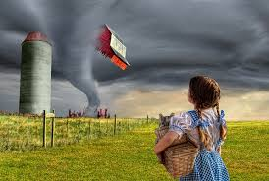
Text Polling
During a semi-annual program review, the IACUC realizes that one of the satellite facilities has been omitted from the Assured institution’s disaster plan.
Notes:
Facilitator: POLLING – Technology Exercise
Turn over your papers for the second scenario. We want you to pick the correct answer from the following options.
This is a departure that has to be recorded on the semi-annual report, but does not have to be reported to OLAW.
This is a departure that has to be recorded on the semi-annual report, and must be reported to OLAW.
This is a departure and must be reported to OLAW.
This is a noncompliance and must be reported to OLAW.

Slide 20
Text Polling
According to the Guide, “Facilities must . . . have a disaster plan.” [Guide, page 35]
Notes:
Facilitator: POLLING – Technology Exercise
Turn over your papers for the second scenario. We want you to pick the correct answer from the following options.
This is a departure that has to be recorded on the semi-annual report, but does not have to be reported to OLAW.
This is a departure that has to be recorded on the semi-annual report, and must be reported to OLAW.
This is a departure and must be reported to OLAW.
This is a noncompliance and must be reported to OLAW.

Slide 21
Is this a departure from the Guide?
This is a departure that has to be recorded on the semi-annual report, but does not have to be reported to OLAW.
This is a departure that has to be recorded on the semi-annual report, and must be reported to OLAW.
This is a departure and must be reported to OLAW.
This is a noncompliance and must be reported to OLAW
Notes:
Facilitator: Select your answer.
Wait for responses and then comment on the results [Most of you selected A,B,C,D.]

Slide 22

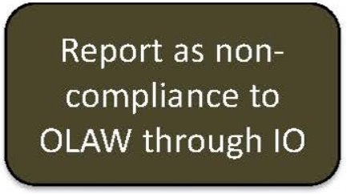
Notes:
Facilitator:
Note that slide is animated (1 click/box).
This is a “must.”
There is no specifically described exception in the Guide for this requirement.
There was no scientific justification, veterinary, or animal welfare basis to deviate from the “must.”
This qualifies as noncompliance, and the assured institution must be reported to OLAW through the IO.

Slide 23
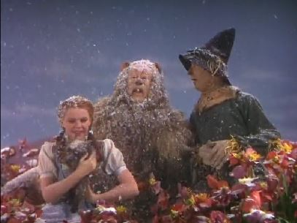
Think, Pair, and Share
A PI plans to use mice for a study looking at brown fat and hypothermia.
The study requires housing some experimental animals in temperatures that are above, within and below the recommended dry-bulb temperatures for mice (20-26 ⁰C).
The PI’s scientific justification is approved by the IACUC.
Notes:
Facilitator: Describes activity - Think, Pair, and Share about the 3rd scenario that is being handed out. We would like for you to classify the action taken by the IACUC, and also describe the committee’s oversight responsibilities relative to this particular study.
Facilitator assistants pass out flow charts and scenarios, and also provide time warnings to the group. 30 secs to think 1 min to pair; and 1 minute to share (use next slide to walk through the sharing section).

Slide 24
Think, Pair, and Share
“Animals should be housed within temperature and humidity ranges appropriate for the species, to which they can adapt with minimal stress and physiologic alteration..” [Guide, page 43]
Notes:
Facilitator: Describes activity - Think, Pair, and Share about the 3rd scenario that is being handed out. We would like for you to classify the action taken by the IACUC, and also describe the committee’s oversight responsibilities relative to this particular study.
Facilitator assistants pass out flow charts and scenarios, and also provide time warnings to the group. 30 secs to think 1 min to pair; and 1 minute to share (use next slide to walk through the sharing section).

Slide 25
Think, Pair, and Share
Classify the action taken by the IACUC, and describe the committee’s oversight responsibilities relative to this study.
Notes:
Facilitator: Describes activity - Think, Pair, and Share about the 3rd scenario that is being handed out. We would like for you to classify the action taken by the IACUC, and also describe the committee’s oversight responsibilities relative to this particular study.
Facilitator assistants pass out flow charts and scenarios, and also provide time warnings to the group. 30 secs to think 1 min to pair; and 1 minute to share (use next slide to walk through the sharing section).

Slide 26

Notes:
Facilitator:
This is a “should”
There is no specifically described exception in the Guide for this requirement.
There is no established performance standard.
The IACUC approved the PI’s scientific justification to deviate from the “should”
This qualifies as a departure, and must be included in the next semi-annual report to the IO.
The IACUC has a responsibility to track this departure, until it no longer applies to the animal care and use program.

Slide 27
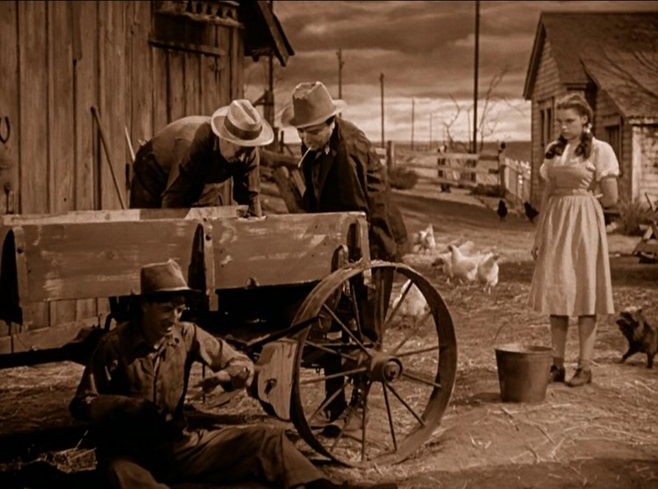
Text Polling
During a semi-annual program review, the IACUC realizes that the light cycle in a room housing chicken was altered by the PI.
The chicken were exposed to excessive dark hours and have lost weight.
Notes:
Facilitator: POLLING – Technology Exercise
Turn over your papers for the fourth scenario. We want you to pick the correct answer from the following options.
This is a departure that has to be recorded on the semi-annual report, but does not have to be reported to OLAW.
This is a departure that has to be recorded on the semi-annual report, and must be reported to OLAW.
This is a departure and must be reported to OLAW.
This is a noncompliance and must be reported to OLAW.

Slide 28
Text Polling
According to the Guide, “Because some species, such as chickens (Apeldoorn et al. 1999), will not eat in low light or darkness, such illumination schedules should be limited to a duration that will not compromise their well-being..” [Guide, page 48]
Notes:
Facilitator: POLLING – Technology Exercise
Turn over your papers for the fourth scenario. We want you to pick the correct answer from the following options.
This is a departure that has to be recorded on the semi-annual report, but does not have to be reported to OLAW.
This is a departure that has to be recorded on the semi-annual report, and must be reported to OLAW.
This is a departure and must be reported to OLAW.
This is a noncompliance and must be reported to OLAW.

Slide 29
Text Polling
Is this a departure from the Guide?
Notes:
Facilitator: POLLING – Technology Exercise
Turn over your papers for the fourth scenario. We want you to pick the correct answer from the following options.
This is a departure that has to be recorded on the semi-annual report, but does not have to be reported to OLAW.
This is a departure that has to be recorded on the semi-annual report, and must be reported to OLAW.
This is a departure and must be reported to OLAW.
This is a noncompliance and must be reported to OLAW.

Slide 30
Notes:
Facilitator:
This is a “should”.
There is no specifically described exception in the Guide for this requirement.
There was no performance standard, scientific justification, veterinary, or animal welfare basis to deviate from the “should”.
This qualifies as noncompliance, and the assured institution must be reported to OLAW through the IO.

Slide 31
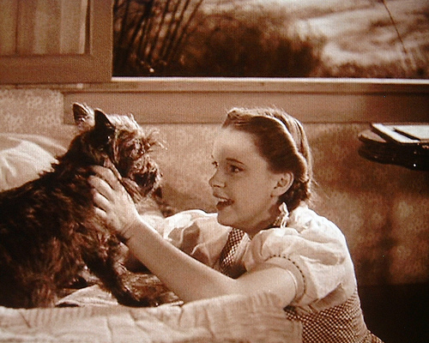
Think, Pair, and Share
After monitoring ammonia levels, humidity, microbial load and other parameters the animal facility has established a cage change frequency of 3 weeks for mice housed in individually ventilated cages.
Notes:
Facilitator:
Facilitator: Describes activity - Think, Pair, and Share about the 3rd scenario that is being handed out. We would like for you to classify the action taken by the IACUC, and also describe the committee’s oversight responsibilities relative to this particular study.
Facilitator assistants pass out flow charts and scenarios, and also provide time warnings to the group. 30 secs to think 1 min to pair; and 1 minute to share (use next slide to walk through the sharing section).
In this scenario the AV and animal housing resources personnel conducted an IACUC approved study to determine the best cage change frequency intervals for their specific program needs.
They looked at environmental factors (CO2, ammonia, cultures, etc.) as well as animal health/wellbeing indices (growth, reproduction, etc.).
Based on data analysis, a cage change frequency of 3 weeks was considered to: maintain animal wellbeing and health while saving costs of more frequent cage changes.

Slide 32

The frequency of sanitation of cages, cage racks, and associated equipment (e.g., feeders and watering devices) is governed to some extent by the types of caging and husbandry practices used, including the use of regularly changed contact or noncontact bedding, regular flushing of suspended catch pans, and the use of wire-bottom or perforated-bottom cages. In general, enclosures and accessories, such as tops, should be sanitized at least once every 2 weeks. [Guide, page 70]
Notes:
Facilitator:
The Guide states ... The frequency of sanitation of cages...

Slide 33
Classify the action taken by the IACUC, and describe the committee’s oversight responsibilities relative to this study.
Notes:
Facilitator:
The Guide states ... The frequency of sanitation of cages...

Slide 34
Notes:
Facilitator:
This is a “should”.
There is no specifically described exception in the Guide for this requirement.
There is a performance standard based on results of a study at the facility.
This is not a departure nor a noncompliance, and reporting is not necessary.

Slide 35
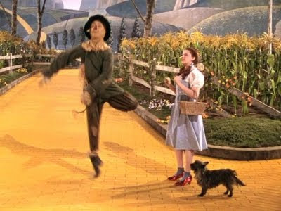
As part of the animal facility environmental enrichment program (which was developed in collaboration with PIs, the AV and facility technical staff and approved by the IACUC), music is played in the animal rooms during the morning hours when cleaning is taking place.
Music is discontinued once all the cleaning activities are completed.
Notes:
Facilitator:
In this scenario the PIs, AV and animal housing resources personnel developed an environmental enrichment program that includes play time, treats, human interaction and the use of music to help minimize noise during the normal cleaning hours.
Music is discontinued once all the cleaning activities have been completed.
The EE program is reviewed/approved by the IACUC.

Slide 36
Radios, alarms, and other sound generators should not be used in animal rooms unless they are part of an approved protocol or enrichment program. Any radios or sound generators used should be switched off at the end of the working day to minimize associated adverse physiologic changes [Guide, page 50]
Notes:
Facilitator:
The Guide states ... Radios, alarms, and other sound generators...

Slide 37
Classify the action taken by the IACUC, and describe the committee’s oversight responsibilities relative to this study.
Notes:
Facilitator:
The Guide states ... Radios, alarms, and other sound generators...

Slide 38
Notes:
Facilitator:
This is a “should”.
There is a specifically described exception in the Guide for this requirement.
This is not a departure, and reporting is not necessary.

Slide 39

A group of rodents is purchased from a reliable commercial vendor and brought into the animal facility for immediate terminal use.
Notes:
Facilitator:
In this scenario the PIs requests immediate access to a new group of mice purchased for immediate terminal use.

Slide 40
Rodents may not require quarantine if data from the vendor or provider are sufficiently current, complete, and reliable to define the health status of the incoming animals and if the potential for exposure to pathogens during transit is considered [Guide, page 110]
Notes:
Facilitator:
The Guide states ... Rodents may not require quarantine...

Slide 41
Classify the action taken by the IACUC, and describe the committee’s oversight responsibilities relative to this study.
Notes:
Facilitator:
The Guide states ... Rodents may not require quarantine...

Slide 42
Notes:
Facilitator:
This is a “may”.
This is not a departure, and reporting is not necessary.

Slide 43
Tracking Departures
The first time the IACUC approves a departure, it must be reported in the next semi-annual to the IO.
A record must be maintained as long as the departure is active and approved.
The IACUC may determine how best to maintain and update records of approved departures.
Notes:
Facilitator: Goes over slide.

Slide 44
What options do you use to track departures?
What other options are available?
Notes:
Consensogram Activity
Facilitator provides overview; Susan records.

Slide 45
A Recap of the Learning Objectives
Define “departure” relative to the Guide.
Compare the terms “must” vs “should” vs “may.”
Differentiate between departures and noncompliance.
Use published guidance on departures correctly.
Determine when departures need to be reported in the semi-annual report and/or tracked.
Notes:
Facilitator: To recap our learning objectives -

Slide 46
Summative Assessment
Define “departure” relative to the Guide.
Analyze the flow chart to identify:
  Three possible conditions for a “must” to be a departure.
  Two possible conditions that prevent a “should” from becoming a departure.
  Possible condition(s) for a “may” to be a departure.
Explain when failure to follow a must, should, or may becomes a deficiency.
Describe when it is necessary to report departures in the semi-annual report to the IO.
Identify three methods of tracking departures.
Notes:
Facilitator – Here’s a way to assess your knowledge.
List three possible conditions for a “must” to be a departure.
IACUC Review of a Scientific Justification – or -
Veterinary Exemption – or -
Animal Welfare Reason
NOTE: Always include in the Semi-Annual Report to the IO.
List two possible conditions that prevent a “should” from becoming a departure.
Specific Guide qualifier/exception.
Local Performance Standard in lieu of the “should”.
List the conditions for a “may” to be a departure.
None – “mays” are not departures.
Explain when failure to follow a must, should, or may becomes a deficiency.
Failure to follow a “must” becomes a deficiency when (1) there’s no Guide exception – or – (2) there’s no IACUC reviewed scientific justification – or – (3) there’s no Veterinary or Animal Welfare rationale subsequently reported to the IACUC.
Failure to follow a “should” becomes a deficiency when (1) there’s no Guide exception – or – (2) there’s no local performance standard in place – or – (3) there’s no IACUC reviewed scientific justification –or – (4) there’s no Veterinary or Animal Welfare rationale subsequently reported to the IACUC.
Failure to follow a “may” is not a deficiency.
Describe when it is necessary to report departures in the semi-annual report to the IO.
In the first semi-annual report after a departure is first approved. No need to include in subsequent reports.
Identify three methods of tracking and/or monitoring departures.
Facilitator will research.

Slide 47

Notes:
Insert music link, mp3, or alternative source...

