Slide 1
Departures from the Guide
Elizabeth Dodemaide, Rutgers University
Jo Ann Henry, NYU School of Medicine
Alison D. Pohl, UConn Health
Claudia Swanson, Yale University
Sandra Wilkins, Michigan State University

Slide 2
DEFINITIONS
Standards = all regulations, policies, and guidelines
Deviation = things different from the “norm”
Departures = deviation from the standards of the Guide that have to be reported
Perceived departures= what you “start with” when reading protocols or found on a semi-annual inspection; may be departures - not sure, need more information
True departure = assessed and confirmed
Must = minimum standard required of all assured institutions
Should = often involve performance standards
May = suggestion that an institution can use if they choose to do so

Slide 3
Definitions
Links for further definitions:
https://grants.nih.gov/grants/olaw/departures.htm

Slide 4
AUDIENCE
Experienced IACUC members
Experienced IACUC administrators
Audience members should have a copy of the Guide

Slide 5
GOAL
To have the audience develop a skill set to evaluate departures from the Guide in conjunction with animal welfare and sound scientific practices
Notes:
Come back-why is this important

Slide 6
OBJECTIVES
Recognize the relevant resources
Identify perceived departures from the Guide
Differentiate between perceived and true departures
Evaluate potential impacts from the departure
Identify reporting requirements and process

Slide 7
RESOURCES
It is essential that IACUC members recognize resources that can be used to determine if “something” in a protocol or found on a semi-annual inspection might be a deviation from the Guide
It is also essential for IACUC members to recognize resources that will help determine if a deviation is reportable to any federal agency

Slide 8
RESOURCES
BRAINSTORM
What are the relevant resources that are used to determine departures from regulatory mandates (for this presentation - the Guide)?

Slide 9
RESOURCES
Guides (8th Edition, Ag guide, “Field guides”)
AWA, AWR, AWS, ACP
PHS Policy
AVMA Euthanasia Guidelines
PHS Assurance
AAALAC Program Description
Subject matter experts

Slide 10
DEPARTURES
As IACUC members, you need to recognize potential departures when reviewing protocols or the animal care and use program e.g. when inspecting animal facilities and labs
It is important to realize that something may or may not be a departure from the Guide

Slide 11
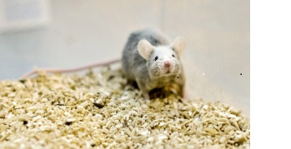
POTENTIAL DEPARTURE? Single Housing
What if this is an adult breeding male?
What if this is 1 of 4 littermates all of the same sex?
What if it is the last experimental mouse in the cage?

Slide 12
THINK-PAIR-SHARE
To do this exercise, get our your copy of the Guide
In your group, identify 5 potential departures from the Guide (2 minutes)

Slide 13
THINK-PAIR-SHARE
Each group is assigned 1 departure (3 minutes)
Develop a scenario in which your departure would be:
Perceived departure
True departure
Not a departure

Slide 14
SINGLE HOUSING EXAMPLE
So, let’s look at our initial example of single housing because if you see “single housing” in a protocol, it should pique your interest
But is it a departure?
Is it a social species?
Is it a fighting male that is going to be separated?
Is it a post-surgical animal where aggression is anticipated and needs to be avoided?
Does it have an exception in the Guide?
You can see that we almost always need more information to be sure

Slide 15
SCENARIOS AND POLLING
SCENARIO ONE
An institution has housed all dogs in small social groups
One of the dogs is older and the AV determines that social housing isn’t appropriate because of arthritis and requires specialized care (e.g., softer flooring)
The IACUC is notified of the requirement for single housing

Slide 16
SCENARIO ONE – POLLING QUESTIONS
Is this a Deviation from the Guide:
A – Yes
B – No
Does this need to be reported in the semi-annual report?
A – Yes
B - No

Slide 17
SCENARIO ONE – ANSWERS
The Guide states that social animals should be housed socially unless they need to be single housed for experimental reasons or incompatability. Single housing should be an exception based on experimental requirements or veterinary concerns about an animal’s well-being
In this scenario, this is a deviation from a should statement but it is acceptable according to the Guide because of the veterinarian’s concern, so it is not a departure from the Guide.
It does not need to be reported in the semi-annual report.

Slide 18
SCENARIOS AND POLLING
SCENARIO TWO
The IACUC is holding its semi-annual review and realizes that one department’s laboratories were not reviewed during the last semi-annual inspection.
The IACUC Administrator informs the IACUC that the laboratories were last inspected 11 months ago

Slide 19
SCENARIO TWO – POLLING QUESTIONS
Is this a deviation from the Guide?
A – Yes
B - No
Does this need to be reported in the semi-annual report?
A – Yes
B - No
Does this need to be reported to a federal agency?
A – Yes
B - No

Slide 20
SCENARIO TWO - ANSWERS
The Guide states that both the HREA and AWA require the IACUC to inspect animal care and use facilities, including sites used for animal surgeries, every six months.
As OLAW expects areas in which animals are used for surgical procedures to be inspected every 6 months, this would be non-compliance with PHS Policy
This must be reported to OLAW, and the IACUC would have to develop a plan of action and a schedule to correct this deviation.

Slide 21
DEPARTURE SUMMARIES – Specifically Described Exceptions
If an activity is performed according to a specifically described exception listed in the Guide, then:
It is not a departure
It does not need to be listed in the semi-annual report
It does not need to be reported to OLAW

Slide 22
DEPARTURE SUMMARIES – Deviating from a Must
If you are deviating from a must statement in the Guide based on IACUC-approved scientific, veterinary, or animal welfare reason, then:
It is an approved departure
It must be detailed in the semi-annual report
It does not have to be reported to OLAW
If you are deviating from a must statement in the Guide and there is no IACUC approval, then:
It is not only a departure, it is non-compliance
It must be reported to the IO
It must be reported to OLAW

Slide 23
DEPARTURE SUMMARIES – Deviating from a Should
If you are deviating from a should statement that is based on an established performance standard, then:
It is not a departure from the Guide
It does not have to be reported in the semi-annual report
It does not have to be reported to OLAW
If you are deviating from a should statement that is based on an IACUC-approved scientific, veterinary, or welfare reasons, then:
It is an approved depature from the Guide
It is reported in the semi-annual report
It does not have to be reported to OLAW
If you are deviating from a should statement without IACUC approval, then:
It is not only a departure, it is non-compliance
It needs to be reported to the IO
It needs to be reported to OLAW

Slide 24
CONCEPT MAPPING
Create a concept map illustrating potential impacts from your assigned departure (5 minutes)

Slide 25
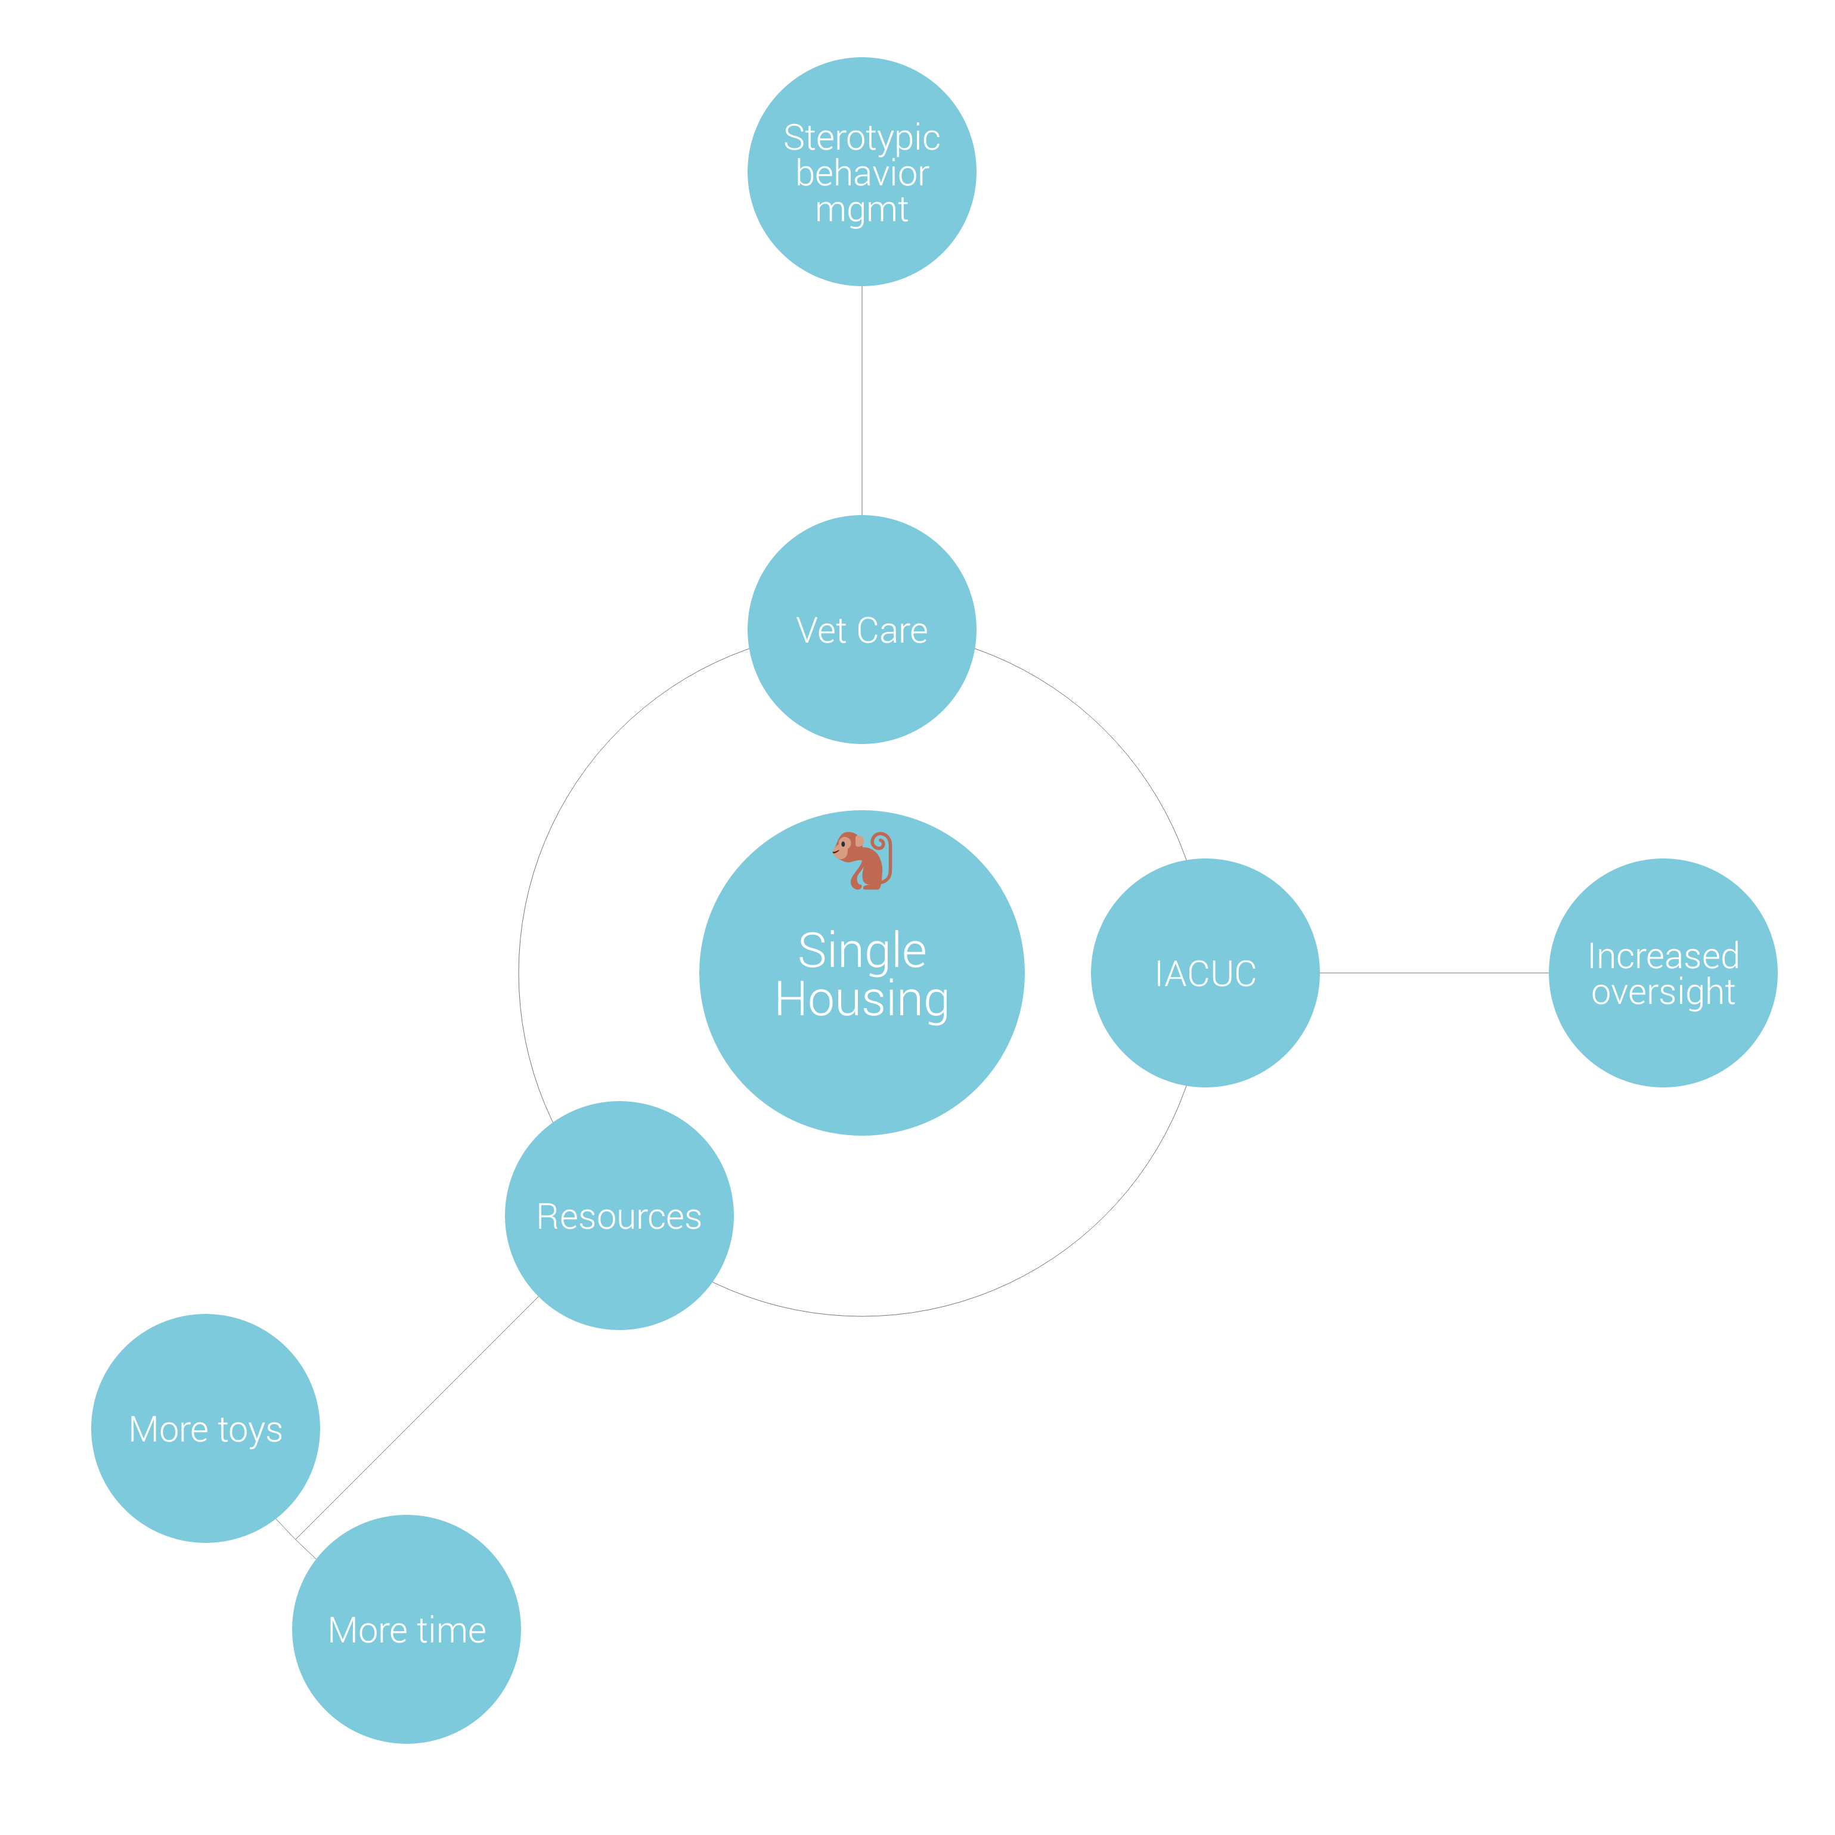
SAMPLE CONCEPT MAP

Slide 26
SUMMATIVE ASSESSMENT
You are reviewing a protocol submission in which the Investigator proposes to singly house cotton rats. The Investigator will bring the animals to his/her laboratory to perform a surgery for implantation of a cannula. The cannula will be used to administer a non-pharmaceutical grade experimental compound and the animals will be housed overnight in the laboratory. Cotton rats will be euthanized by lethal injection.

Slide 27
SCENARIO QUESTIONS
1. Identify the perceived departures in this scenario.
2. List the relevant resources to evaluate the perceived departures.
3. What further information is needed to determine if the perceived departures are true?
4. As written, do any potential departures require reporting and, if so, to whom and why?

Slide 28
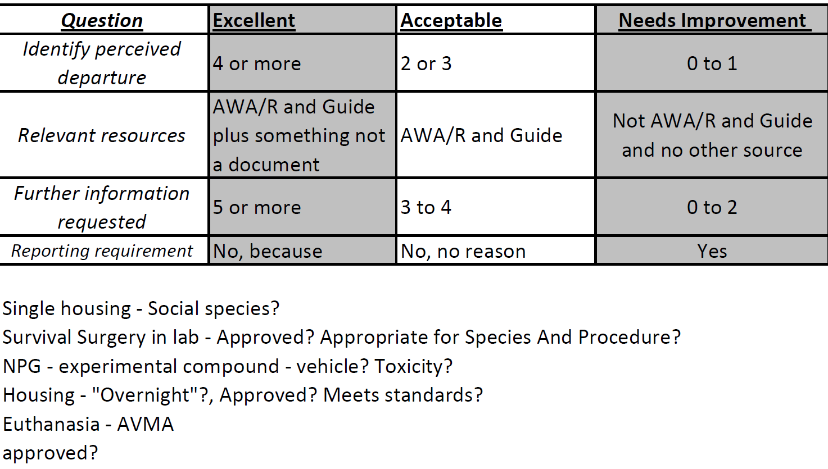
RUBRIC

Slide 29
SUMMARY
Following this module you should now be able to:
Recognize the relevant resources
Identify perceived departures from the guide
Differentiate between perceived and true departures
Evaluate potential impacts from the departure
Identify reporting requirements and process

Slide 30
Acknowledgements
Special thanks to Dr. Patricia A. Brown, Director, OLAW. Her OLAW online seminar (9/13/12, revised 10/4/12) was instrumental for this training.

