Slide 1
Group A
Alice Huang, Kiirsa Pokryfke, Ernie Prentice,
Stacy Pritt, William Singleton
Topic: Pain & Distress/Humane Endpoints
Notes:
There is an ethical and regulatory imperative that animal pain and distress be identified and appropriately alleviated. This is a mandate that the IACUC fulfills through protocol review.
Note to the Facilitator: Scientific/medical language is utilized in this module since these terms are frequently encountered during protocol review. Considerations may be needed for new IACUC members who are English Language Learners (ELLs).

Slide 2
Goal
Understand how to effectively review protocols to ensure pain & distress are minimized consistent with sound research design
Notes:
To that end the goal of this training is to help new IACUC members understand how to effectively review protocols to ensure that pain & distress are minimized consistent with sound research design.
This training module is ideal for IACUC staff or Chairs to use when training brand-new IACUC members in groups of 5 or less.
Because this training is intended with brand-new, inexperienced IACUC members or little to no previous exposure to the standards.
We think that you will have the most fun in this learning module if you pretend to go through the activities as novices.

Slide 3
Objectives
1) Define pain, distress, experimental endpoints, and humane endpoints
2) Evaluate the potential for pain and distress
3) Determine the acceptability of the management of possible pain and distress
4) Ensure an appropriate link between experimental and humane end points
Notes:
We have four objectives to achieve this goal. At the end of this training the new IACUC members should be able to 1, 2, 3, 4.

Slide 4
Painful, Distressful, Neither, or Both? (2 Mins)
Assign the best descriptor for each procedure listed below:
Bone marrow depletion via irradiation in a mouse
Head cap placement surgery in a song bird
Laparotomy in a rabbit
MRI imaging of a pig while it is anesthetized
Singly housed NHP
Study design which includes mice in cages and cats walking around the room
Treadmill running stimulus via foot shock for a mouse
Notes:
5 Charts – one per table
Each table has 7 pre made stickies
Each table selects a row for each of their stickies
The 4 rows are labeled as Pain, Distress, Neither, or Both - These row assignments are not to be reflective of USDA pain column classifications, this activity is to focus on initial thoughts and “gut reactions” upon reading the procedure description.
Note to the Facilitator: This list of 7 items can be made more specific to an institution. For example, if your institution does not utilize NHPs in research, an NHP example may not be needed.

Slide 5
Definitions from the Standards
USDA AC Policy #11: A painful procedure is defined as any procedure that would reasonably be expected to cause more than slight or momentary pain or distress in a human being to which that procedure is applied, that is, pain in excess of that caused by injections or minor procedures.
Guide pg. 121: Distress may be defined as an aversive state in which an animal fails to cope or adjust to various stressors with which it is presented. But distress may not induce an immediate or observable pathologic or behavioral alteration, making it difficult to monitor and evaluate the animal’s state when it is present.
Notes:
Didactic exercise – Provide definitions from two standards to guide subsequent discussion, facilitator should provide background of origin and significance of each standard
If more time was allowed, trainees could be encouraged to find these and other definitions from the standards on their own through web searchers or reviewing documents. Think-Pair-Share and Collaborative Learning exercises could also be used to have attendees discuss amongst themselves their thoughts and ideas on the defintiions and how they think of procedures as painful or distressful.

Slide 6
Review & Revise? (5 Mins)
Bone marrow depletion via irradiation in a mouse
Head cap placement surgery in a song bird
Laparotomy in a rabbit
MRI imaging of a pig while it is anesthetized
Singly housed NHP
Study design which includes mice in cages and cats walking around the room
Treadmill running stimulus via foot shock for a mouse
USDA AC Policy #11: A painful procedure is defined as any procedure that would reasonably be expected to cause more than slight or momentary pain or distress in a human being to which that procedure is applied, that is, pain in excess of that caused by injections or minor procedures
Guide pg. 121: Distress may be defined as an aversive state in which an animal fails to cope or adjust to various stressors with which it is presented. But distress may not induce an immediate or observable pathologic or behavioral alteration, making it difficult to monitor and evaluate the animal’s state when it is present.
Notes:
Question to group - Would you change your answer based on the information just provided, please discuss at the table acting as novice IACUC members. Changes should be made to the row assignments for the stickies, as desired.
We will select a table to report out their answer starting with their initial assignment, if any changes were made, and the reasoning behind those decisions?
For new IACUC member training, with the groups of 5 or less, group would report out for each of the 7 procedures, allowing the facilitator to assess responses.
Note to the Facilitator: This could be an opportunity for new IACUC members to research these procedures on the web or in an existing protocol (similar to what would be done during protocol review).

Slide 7
Humane & Experimental Endpoints
Experimental endpoints are those outcomes needed to achieve research goals. Specific criteria that will allow recognition of when the experimental outcomes have been met should be identified.
Humane endpoints are defined criteria and interventions which are used instead of more severe experimental outcomes such as advanced clinical disease or death.
Using humane endpoints allows scientists to minimize pain and distress while carrying out studies to understand and develop treatments for diseases.
Adapted from the 3Rs Centre Utrecht Life Sciences and the Guide
Notes:
In addition to pain and distress, humane and experimental endpoints are critical to the review of protocols to ensure appropriate animal well-being.
These definitions also provide an opportunity for a facilitator to discuss relevant institutional policies about humane endpoints that are a part of protocol review.

Slide 8
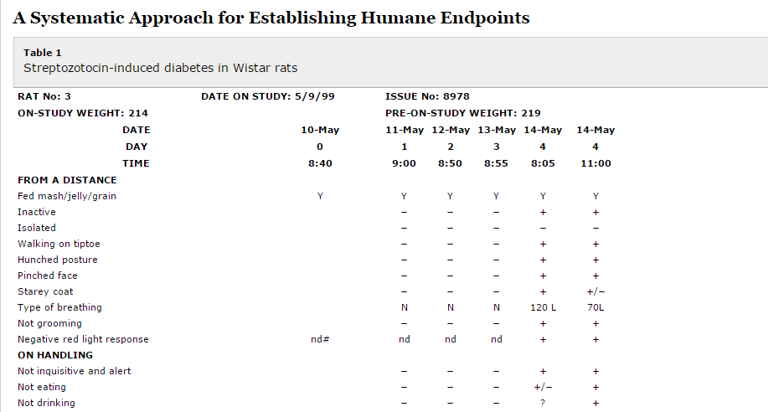
Example Humane Endpoint:
An animal must be euthanized once it has been observed to not be eating or drinking for greater than 24 hours
Morton, D. 2000 ILAR Journal Volume 41 Issue 2 Pages 83-86
Notes:
Plus sign indicates present, negative sign indicates not present (normal), +/- indicates that the observer is unsure, ND means not determined. The more pluses present provide a visual indication of how far the animal has deviated from normal.
Note to the Facilitator: This may be the time to discuss institutional policies and/or utilize institutional specific examples (rather than the one from the ILAR Journal on this slide). This example contains a lot of clinical signs and new IACUC members may not be aware of what those clinical signs entail.

Slide 9
Evaluate a Pain & Distress Management Plan (5 Mins)
Chronic Heart Failure Model in a hamster subsequent to coronary artery ligation performed via a thoracotomy
Formulate two questions/group:
B) Pre-operative measures
C) Intraoperative measures
D) Post-operative measures
E) Veterinary Support
F) Humane endpoints for this model
Notes:
Each table is assigned an aspect of protocol review as described in the slide for a chronic heart failure model in a hamster subsequent to coronary artery ligation performed via a thoracotomy.
Each table will formulate two questions, relative to the assigned aspect, that a protocol reviewer should ask him/herself to help ensure minimization of pain and distress.
In a smaller group, each trainee would be assigned an aspect of protocol review, work on developing the two questions independently, and then each person will report out and group discussion would follow.
We will pick on group F to report out

Slide 10
Objectives Review
1) Define pain, distress, experimental, and humane endpoints
2) Evaluate the potential for pain and distress
3) Determine the acceptability of the management of possible pain and distress
4) Ensure an appropriate link between experimental and humane end points

Slide 11
Summative Assessment – Mock IACUC Meeting
On an individual basis, each trainee will identify the problems, deficiencies, and concerns in the scenario and document their findings (the documentation will eventually be given to the facilitator).
In a mock IACUC meeting, each individual will be asked to identify and present one of their findings. The individual should articulate the significance of the identified issue.
After all of the trainees have presented one issue, the facilitator will open up the protocol scenario for further discussion about other issues not previously identified.
The facilitator will be provided a list (key) of concerns, issues, and deficiencies as identified by experts that can be used to assess the trainee’s comprehension.

